Slide 1
Mathematical Parser and Calculator
20195061 Park, Kyeong Seop
20195073 Park, Jun Ho

Slide 2
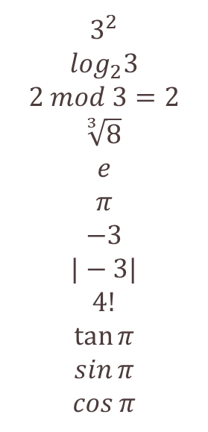
Explanations of Symbols
^
v
m
r
e
PI
n
a
!
t
s
c
power
log
mod
root
constant e
constant pi
negative sign
absolute sign
factorial
tangent
sine
cosine
3 ^ 2
2 v 3
2 m 3
3 r 8
e
PI
n3
an3
4!
t PI
s PI
c PI
$$3^{2}$$
$$\log_{2}3$$
$$2 mod 3=2$$
$$\sqrt[3]{8}$$
$$e$$
$$π$$
$$−3$$
$$|−3|$$
$$4!$$
$$\tan{π}$$
$$\sin{π}$$
$$\cos{π}$$

Slide 3
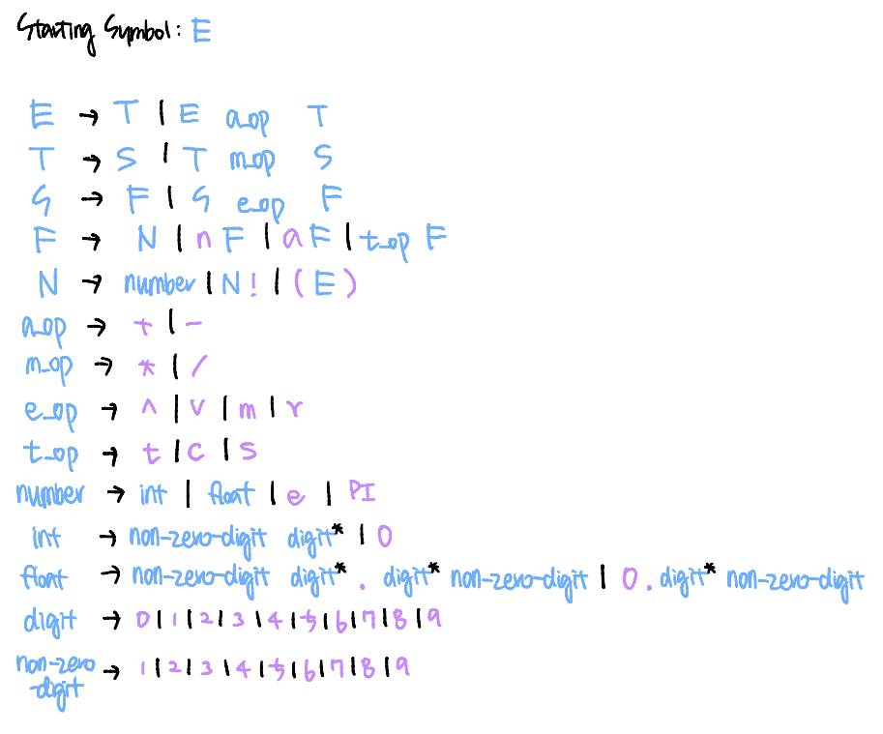
Derivation Rule
Starting Symbol : E
Variable : E, T, S, F, N
Terminals
a_op, m_op, e_op, t_op,
n, a, !, (, )
yacc
lex

Slide 4
Derivation Rule
Precedence Rule
()
!
t_op, a, n
e_op
m_op
a_op
yacc
lex

Slide 5
Lex / Yacc
Lex / Yacc is based on LALR parser generator
Verified if our derivation rule meets the LALR parser language
Formed a SLR(1) Parsing Table for our derivation rule
Expression Power : SLR < LALR,
We can say that our language meets
LALR language
LR(0)
SLR
LALR
CLR

Slide 6
SLR Parsing Table
Expression Power : SLR < LALR,
We can say that our language meets LALR language

Slide 7
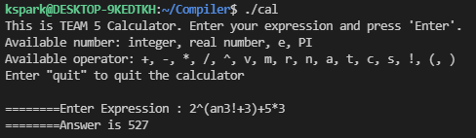
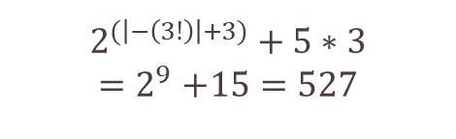
Features of our Calculator Parser
1) Our Calculator Parser gives the answer of the input expression
Can Easily Check if the Precedence Rule is Correct
$$2^{(\left|−\left(3!\right)\right|+3)}+5∗3$$
$${=2}^{9}+15=527$$
2) Have thought of EVERY ERRORS and handled all of them!!
=> Used Nondeterministic Automata (NFA) / Regular Expressions in Lex /
Alternative Derivative Rules in Yacc
3) Show where the ERROR happened and spot the incorrect character

Slide 8
Instance of Error Messages
Missing Number
Too Much Operator
Missing Operator
Useless Parenthesis
Missing Opening Bracket
Missing Closing Bracket
Unexpected Character
Semantic Warning (Divided by Zero, Log of Zero)
Semantic Error (Invalid Log Base/Mod/Root, Negative Factorial)
Idea of NFA
Lex
(Regular Language)

Slide 9
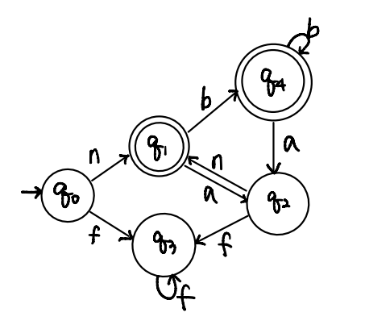
Concept of Error Identification (NFA)
Divided the terminals into 4 states
Number (q1), Operator that goes between operands (q2),
in front of an operand (q3), back of an operand (q4)
Ex)
a : [+-*/^vmr]
f : [natcs]
b : [!]
n : number

Slide 10
Concept of Error Identification (NFA)
State -> State
Blue : Accept (Nothing Wrong)
Gold : Missing Number
Ex) +3-2 , !4^2
Green : Too Much Symbol
Ex) ++3 , +!4-2 , n+3!
Red : Missing Symbol
Ex) 2 3 , 2! 2+3
White : Blank Expression

Slide 11



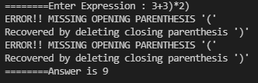


Examples of Error Recoveries
1 ) Missing Number
4 ) Useless Parenthesis
2 ) Too Much Operator
5) Missing Opening Bracket
3 ) Missing Operator
6 ) Missing Closing Bracket

Slide 12

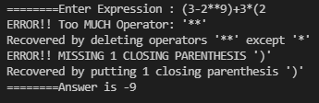


Examples of Error Recoveries
7 ) Unexpected Character
+ Display Multiple Errors
8 ) Semantic Warning
9) Semantic Error

